Slide 1
Normalization of floating point numbers
Normalization means adjusting a floating-point number so that there is exactly one non-zero digit (1) to the left of the binary point.

Slide 2
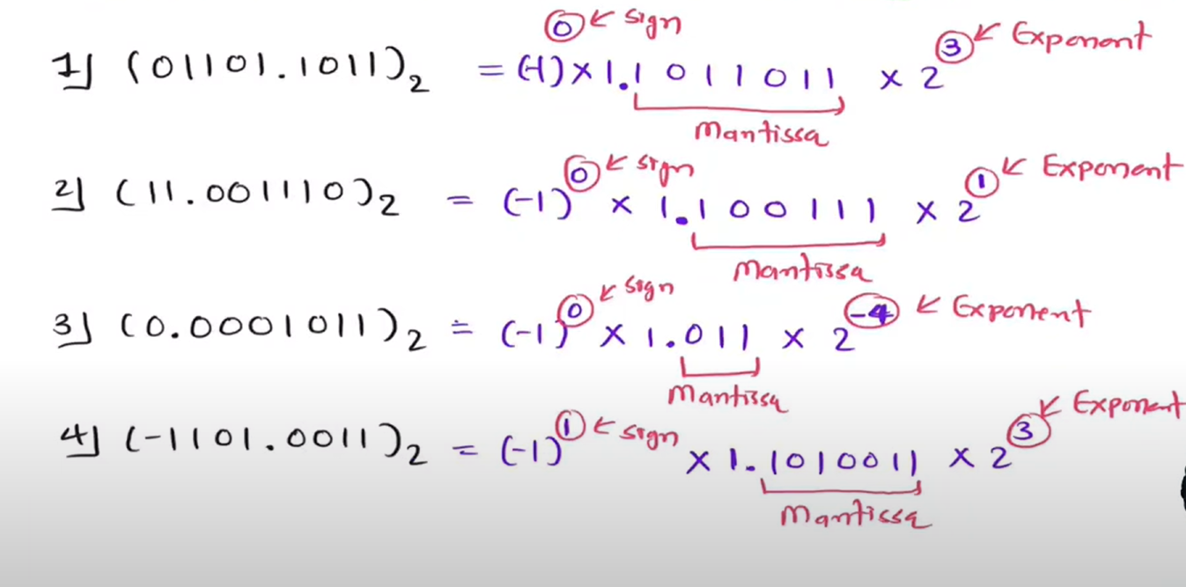

Slide 3
Floating-Point Numbers
A binary floating-point number is represented by (2008 version of IEEE Standard 754):
  a sign for the number
  some significant bits
  a signed scale factor exponent for an implied base of 2

Slide 4
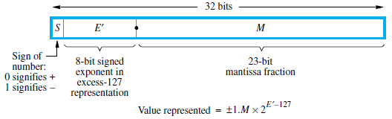
IEEE standard floating-point formats (32 bit)
The basic IEEE format is a 32-bit representation that comprises of
  a sign bit,
  23 significant bits, and
  8 bits for a signed exponent of the scale factor

Slide 5
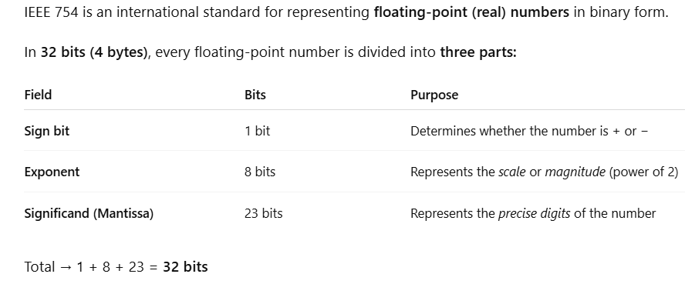

Slide 6
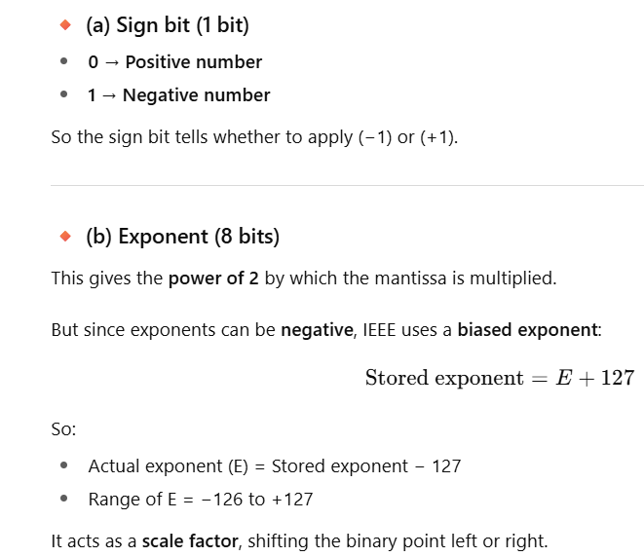

Slide 7
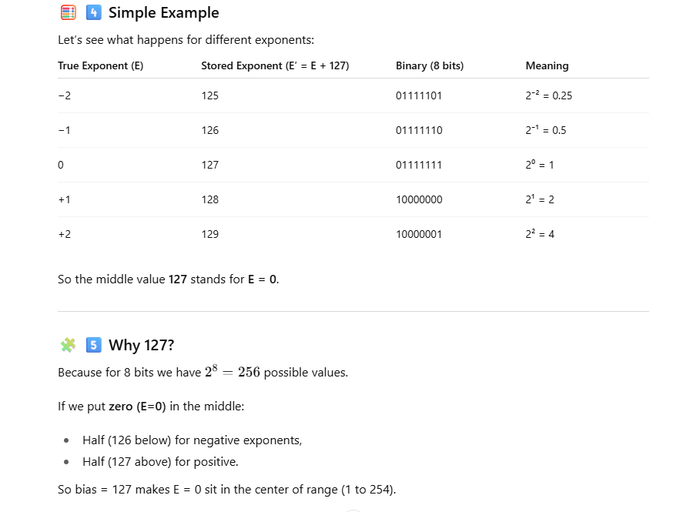

Slide 8
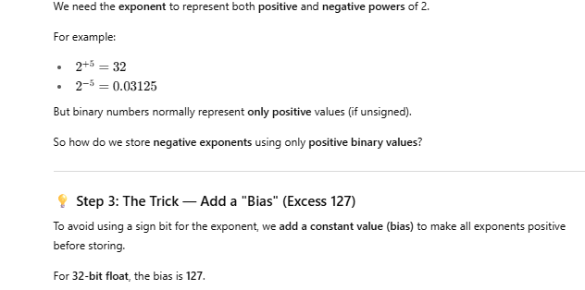

Slide 9
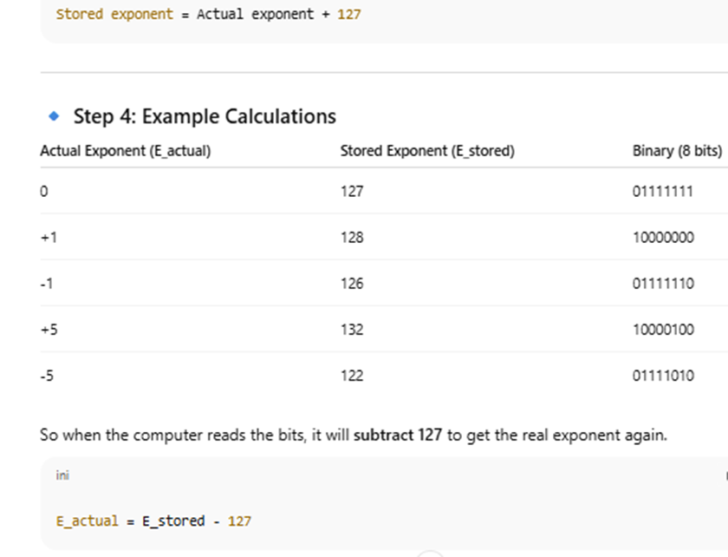

Slide 10
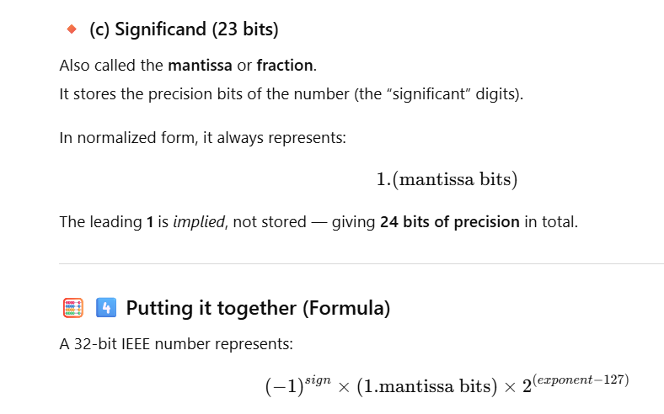

Slide 11
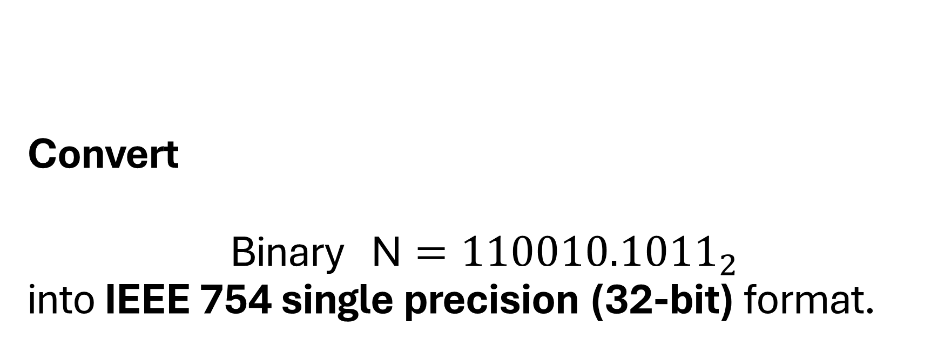
Convert
$$\text{Binary} \text{N}={110010.1011}_{2}$$ into IEEE 754 single precision (32-bit) format.

Slide 12
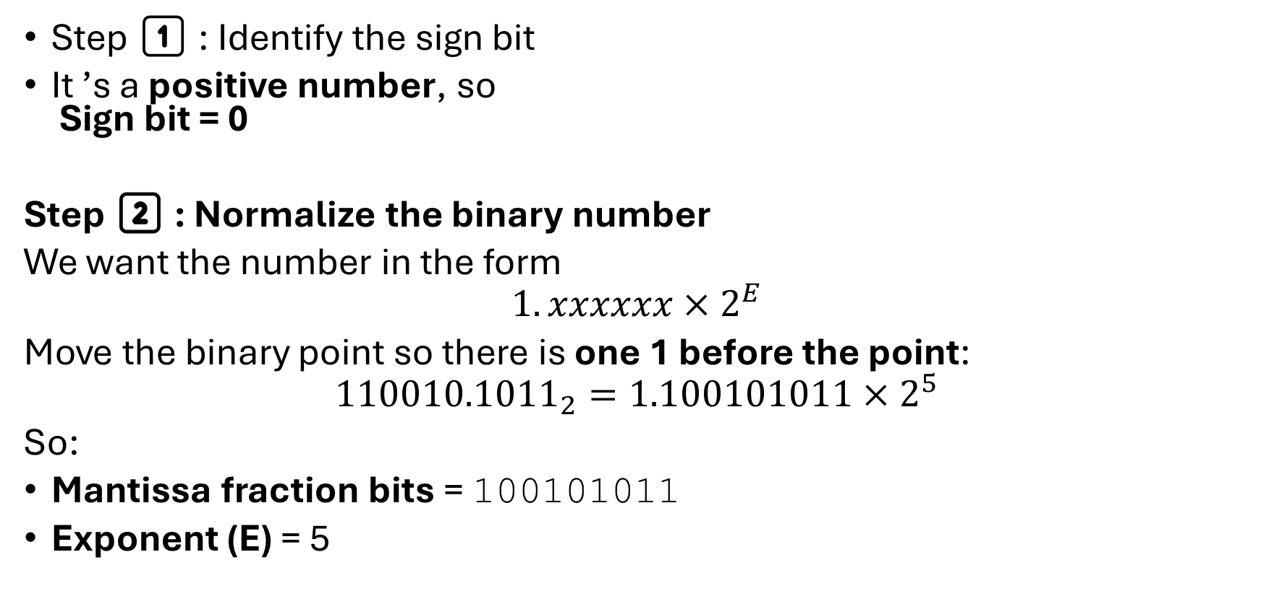
Step 1️⃣ : Identify the sign bit
It ’s a positive number, so
Sign bit = 0
Step 2️⃣ : Normalize the binary number
We want the number in the form
$$1.xxxxxx×2^{E}$$
Move the binary point so there is one 1 before the point:
$${110010.1011}_{2}=1.100101011×2^{5}$$
So:
Mantissa fraction bits = 100101011
Exponent (E) = 5

Slide 13
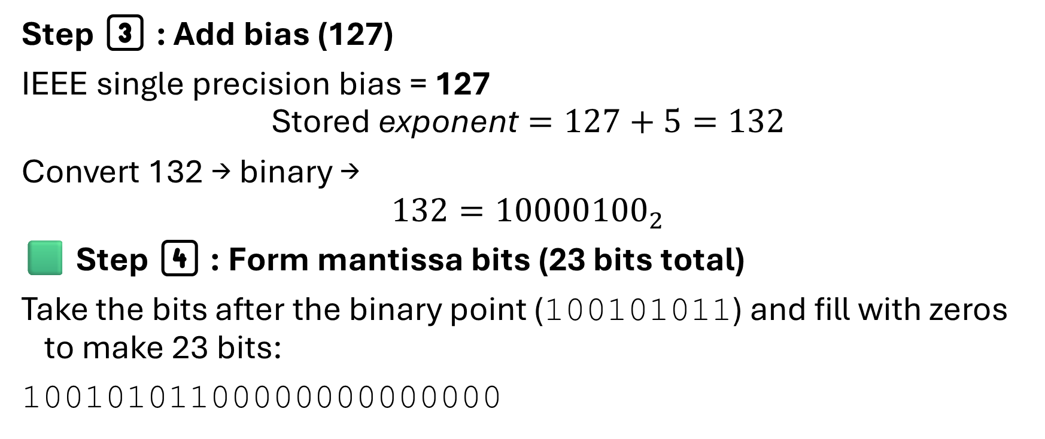
Step 3️⃣ : Add bias (127)
IEEE single precision bias = 127
$$\text{Stored} \text{exponent}=127+5=132$$
Convert 132 → binary →
$$132={10000100}_{2}$$
🟩 Step 4️⃣ : Form mantissa bits (23 bits total)
Take the bits after the binary point (100101011) and fill with zeros to make 23 bits:
10010101100000000000000

Slide 14
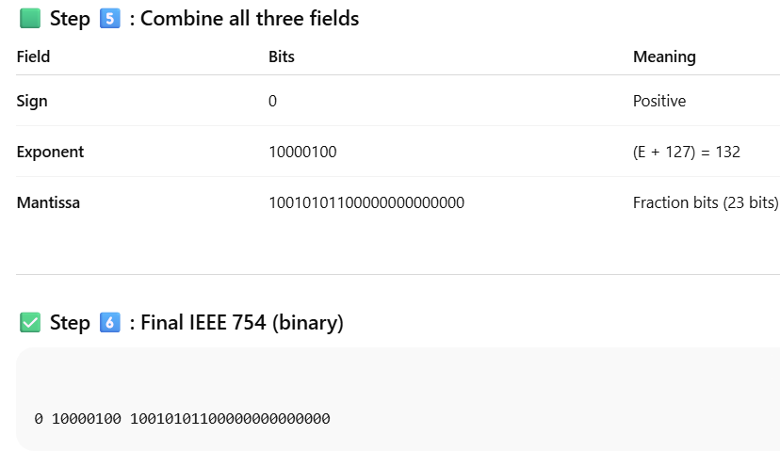

Slide 15
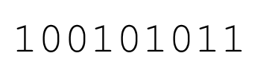
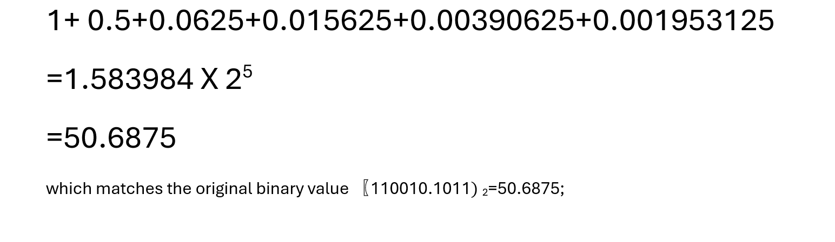

Slide 16
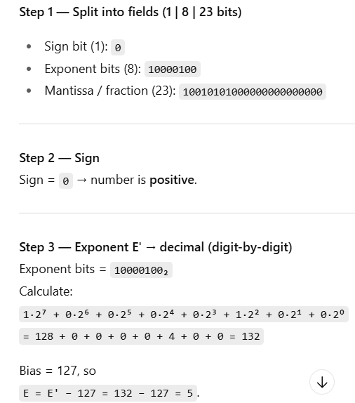
Steps to convert 32-bit representation to decimal
Given IEEE 32 bit representation of a number
0100 0010 0100 1010 1000 0000 0000 0000

Slide 17
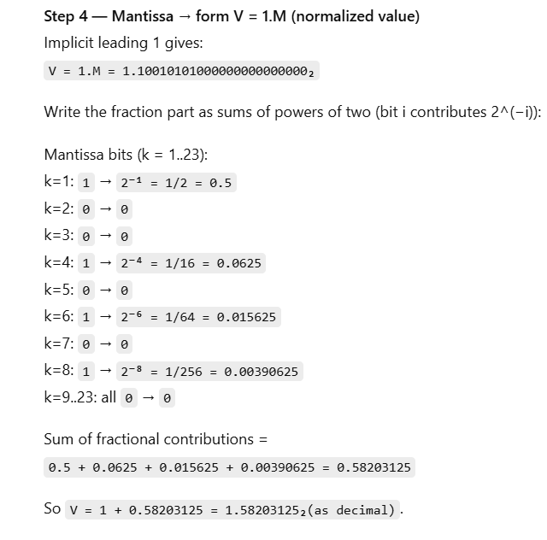

Slide 18
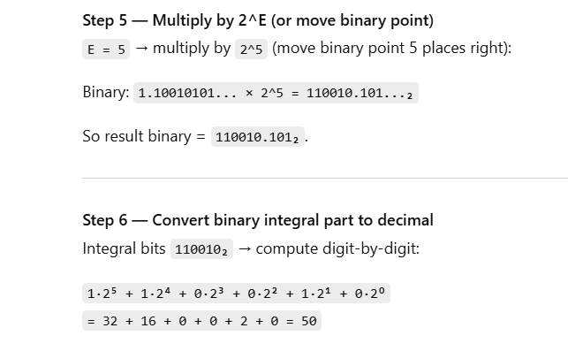
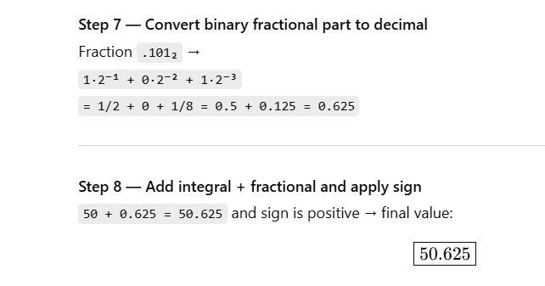

Slide 19
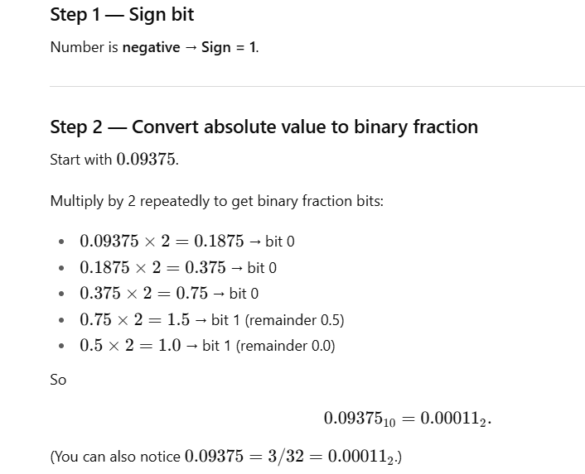
Given decimal number -0.09375, represent in in IEEE754 format

Slide 20
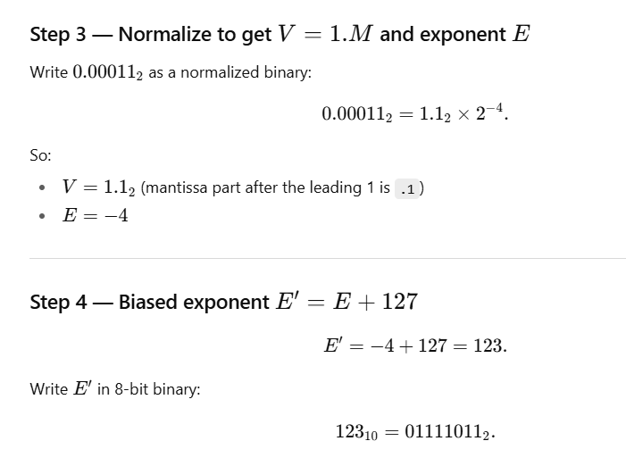
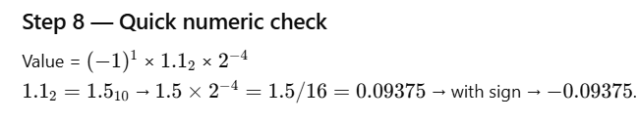

Slide 21
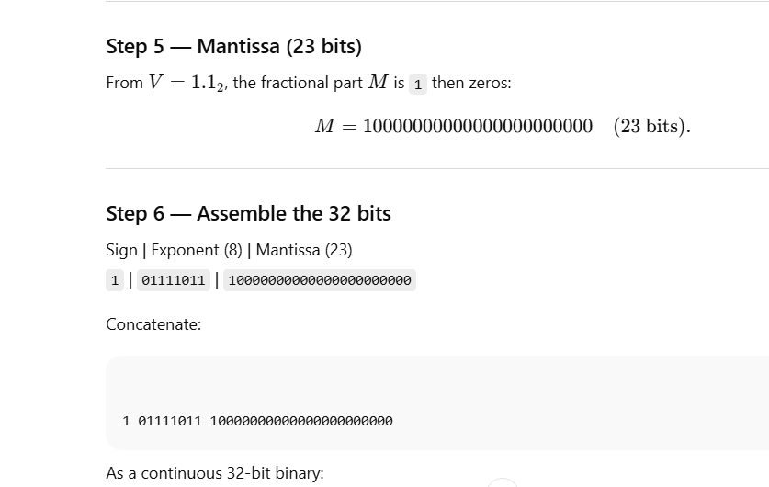

Slide 23
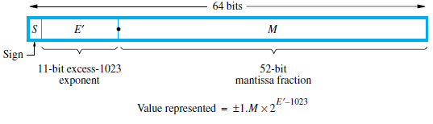
IEEE standard floating-point formats (64 bit)
IEEE standard also defines a 64-bit representation to accommodate
  more significant bits, and
  more bits for the signed exponent, resulting in much higher precision and a much larger range of values
The 11-bit excess-1023 exponent E’ has the
  range 1 ≤ E’ ≤ 2046 for normal values, with 0 and 2047 used to indicate special values,
  The actual exponent E is in the range −1022 ≤ E ≤ 1023
  providing scale factors of 2⁻¹⁰²² to 2¹⁰²³ (approximately 10^{±308})

Slide 24

Field | Bits | Purpose
Sign bit (S) | 1 bit | 0 → positive, 1 → negative
Exponent (E’) | 11 bits | Stores exponent (with bias 1023)
Mantissa / Fraction (M) | 52 bits | Stores significant digits (after the binary point)

Slide 25
Add/Subtract Rule
Choose the number with the smaller exponent
Shift its mantissa right to the number of steps equal to the difference in exponents. (Shift point to left)
Set the exponent of the result equal to the larger exponent.
Perform addition/subtraction on the mantissas and determine the sign of the result.
Normalize the resulting value, if necessary.

Slide 26
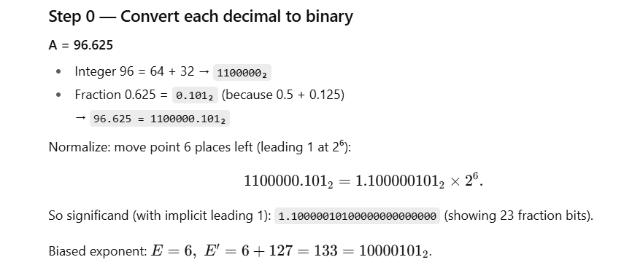
Addition example 1 binary A= 96.625 and B= 12.125
In IEEE 32-bit format: A= 0 10000101 10000010100000…….

Slide 27
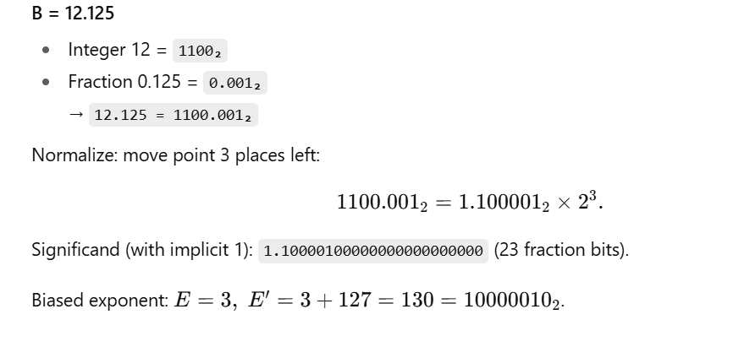

Slide 28
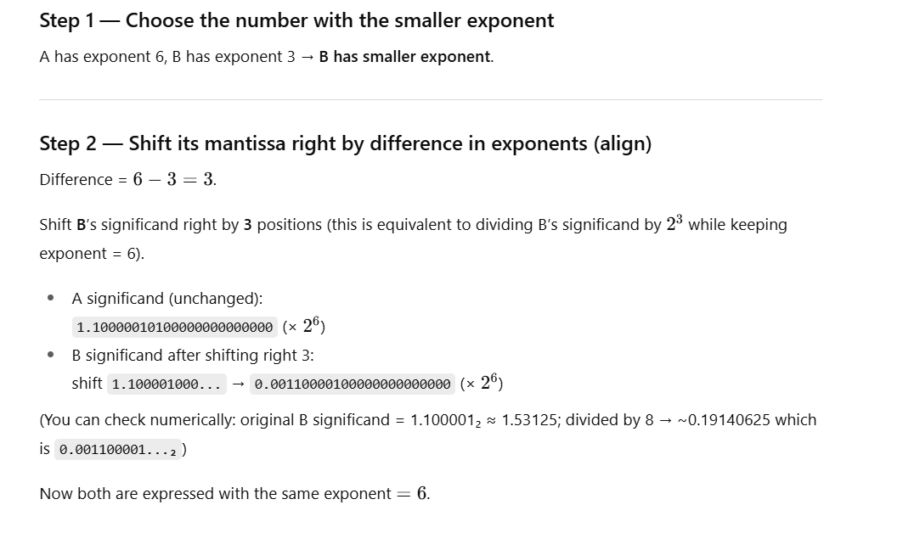

Slide 29
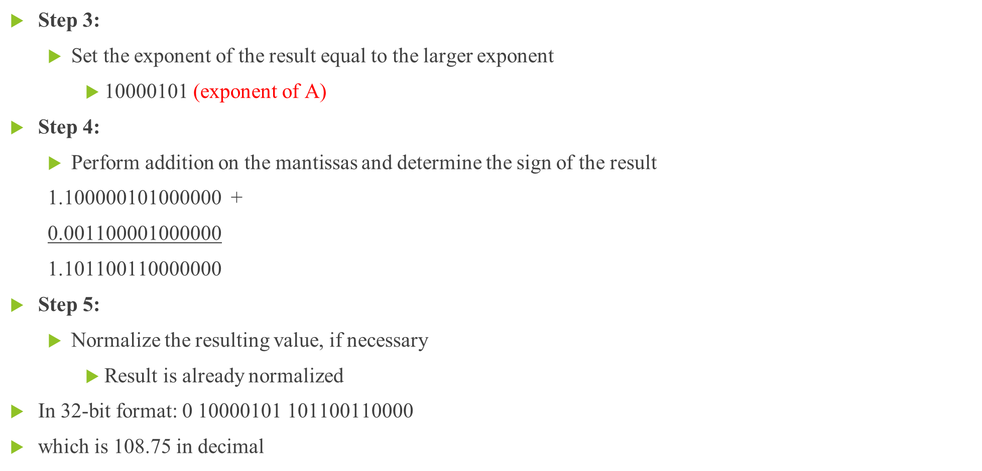
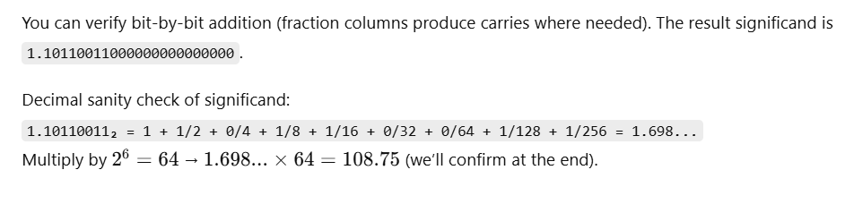

Slide 30
Addition example 2 binary A=15.5 + B=15.5

Slide 31
Addition example- binary
A=15.5 + B=15.5
Step i: Convert A to binary representation
  1111.1 ➔After normalizing we get 1.1111 X 2³
  E’= 3+127=130 =10000010
  In IEEE 32-bit format: A= 01000001011110000000000000000000
Step ii: Convert B to binary representation
  1111.1 ➔After normalizing we get 1.1111 X 2³
  E’= 3+127=130 =10000010
  In IEEE 32-bit format: B= 01000001011110000000000000000000
Step 1: Choose the number with the smaller exponent and shift its mantissa right a number of steps equal to the difference in exponents.
  Both are of equal exponent. Hence no shift
Step 2:
  Set the exponent of the result equal to the larger exponent
    10000010 (exponent of A or B)

Slide 32
Addition example- binary
Step 3:
  Perform addition on the mantissas and determine the sign of the result
  1.11110000000000000000000 +
  1.11110000000000000000000
  11.11100000000000000000000
Step 4:
  Normalize the resulting value, if necessary
    1.111100000000000000000000 × 2¹
  Adjust resultant exponent E’ by adding exponent from the normalized resultant mantissa
  10000010 + (if the exponent is –ve, subtract it from resultant E’)
  00000001
  10000011
In 32-bit format: 0 10000011 111100000000000000000000
which is 31.0 in decimal

